Slide 1
Brainstem Test for Brain Death Determination

Slide 2
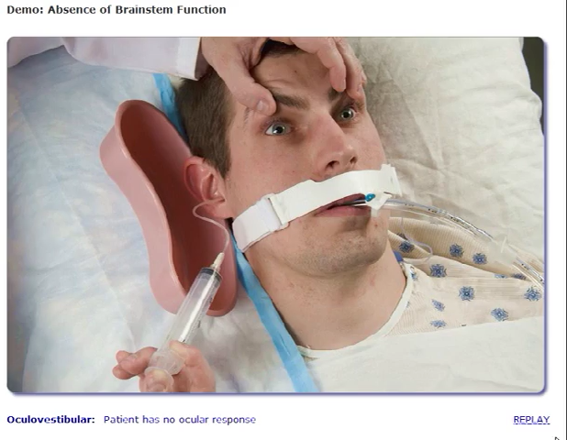
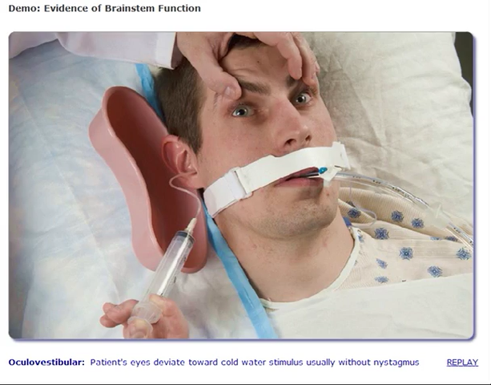
Cold Caloric Testing
(Oculovestibular response)
Absent Response
Normal Response

Slide 3
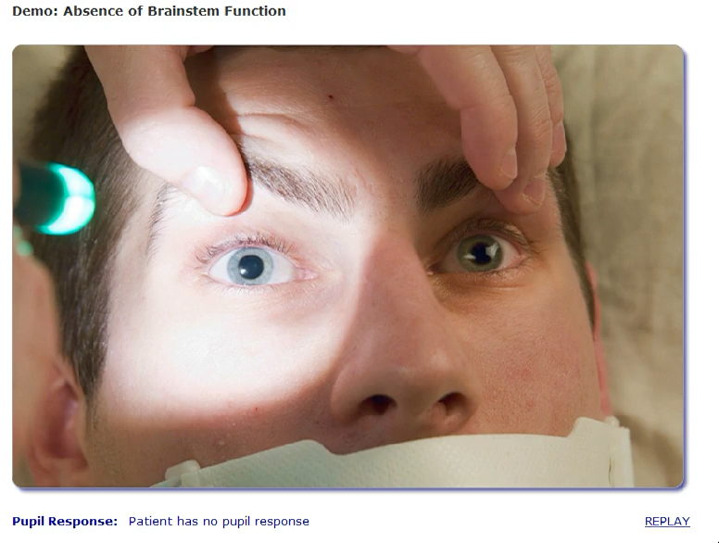
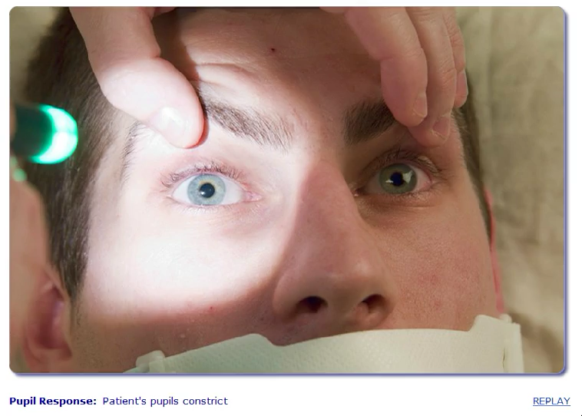
Pupillary Reflex Testing
Absent Pupillary response
Normal Response

Slide 4
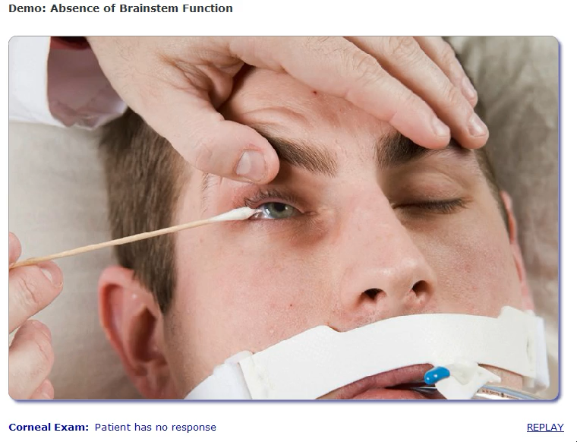
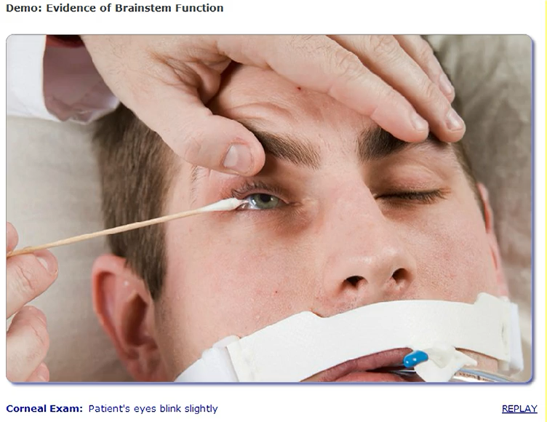
Corneal Reflex Testing
Absent response
Normal Response

Slide 5
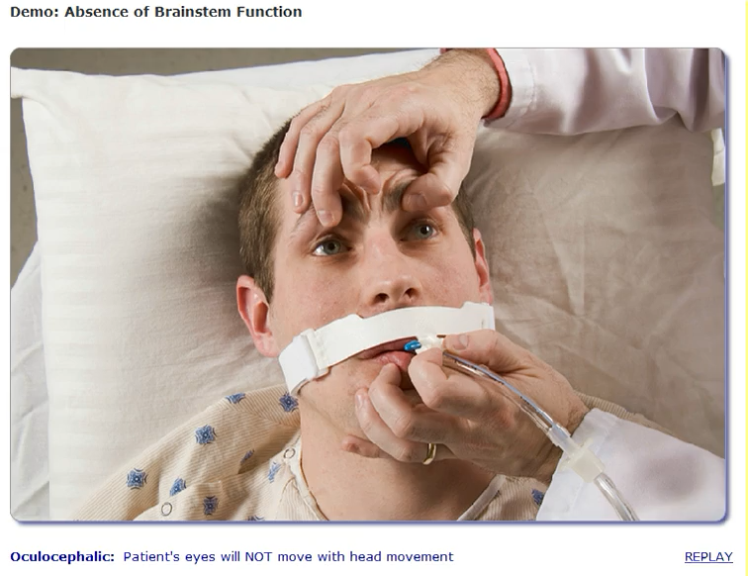
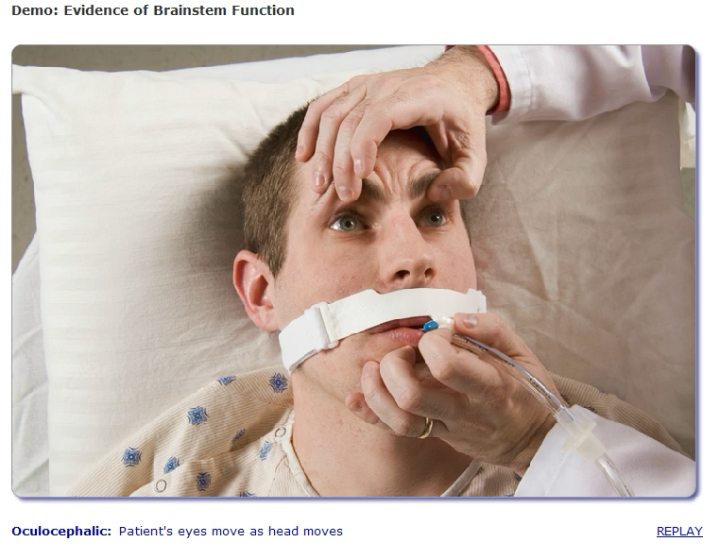
Doll’s Eye Testing (Oculocephalic reflex)
*Do not attempt if with suspected or confirmed cervical spine injury
Abnormal response
Normal Response

Slide 6
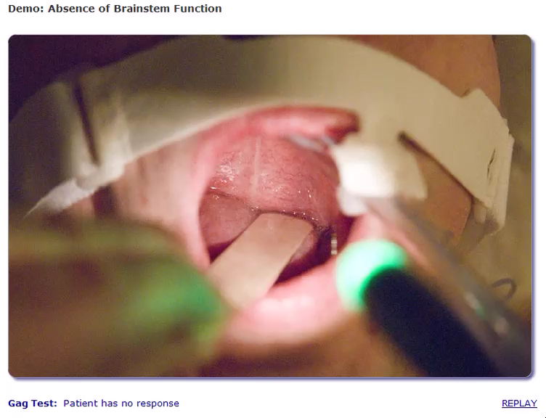
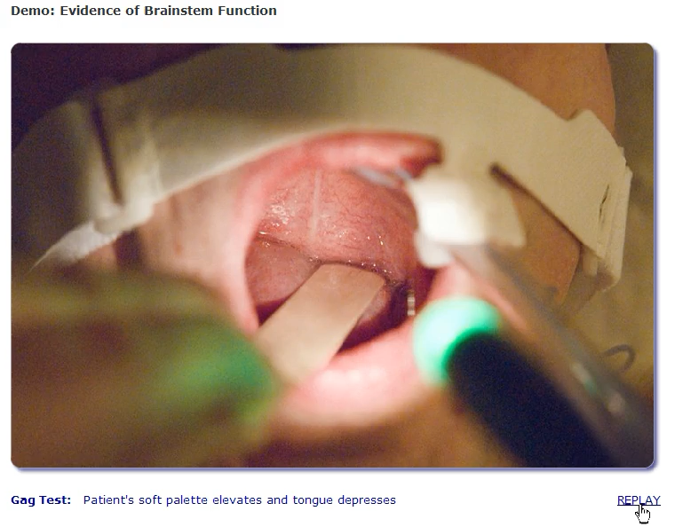
Gag Reflex Testing
Absent Response
Normal Response

